Slide 1


Date
Apr 25, 2025
Wishful
Bazaar
Sales Performance & Getting to Know Our Customers
by
Batch
Assignment
Linkedin
Link
Ahmad Rizki
RevoU FSDA batch FEB25
Intermediate
Data Visualization
www.linkedin.com/in/arizabdulhanan
Tableau Link

Slide 2

Business Requirement & Objective
1
Why
3
The reason is to help CEO in understanding business performance better with capture and understand more metrics and make data more comprehensive and insightful.
Who
2
What
The dashboard is made based on CEO request to understand our business performance better. So, the user of the dashboard is Mr. Ronaldinho as CEO himself, Mr. Neymar as Head of Data, and also the other executives.
By addressing some metrics that are suitable the company’s needs, such as :
- Sales Success
- Abandoned Sales
- Return Sales
- Purchase Order per Month
- Session Duration per Customer
- Company Profit

Slide 3
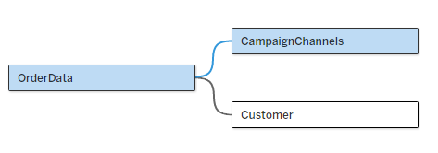


Data Preparation
Connect and Combine / Join
Add a connection to WishfulBazaar dataset. The files that we used in Excel file format.
Combine the three tables (OrderData, CampaignChannels, and Customer) with OrderData to CampaignChannels using Session ID and OrderData to Customer using Customer ID.
The reason why we choose combine than join is because combine is more flexible, intuitive, and less errors. It preserve all data rows, similar to full outer join. And also, it maintain the original structure and level of detail from each table.

Slide 4
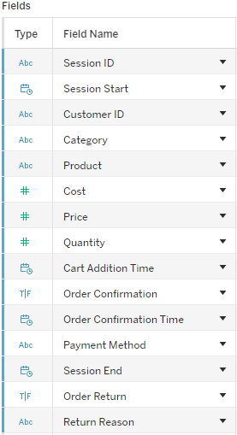
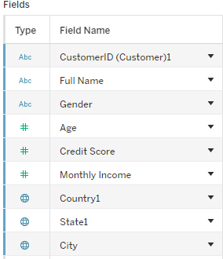
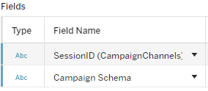
Data Preparation
Check Data Type
Campaign Channel Table
- Convert Session ID into string
Customer Table
- Convert Customer ID into string
- Convert Monthly Income into USD currency
Order Table
- Convert Customer ID into string
- Convert Session ID into string

Slide 5


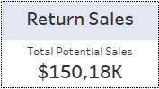
Data Visualization
Sales Success, Abandoned Sales, and Return Sales
Total actual sales that Company made.
Total potential sales that Company can made if the order is accepted.
Total potential sales that Company can made if no sales return.

Slide 6
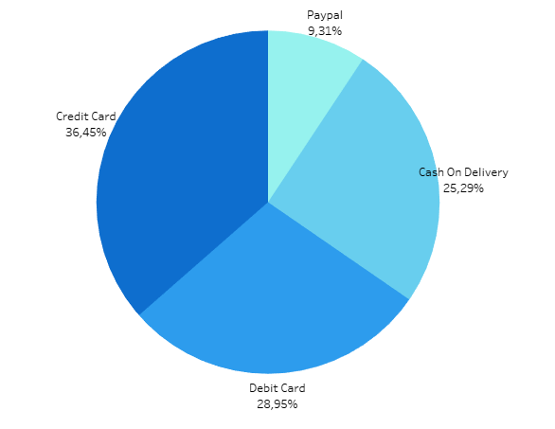
Data Visualization
Payment Method Preferences per Sales

Slide 7
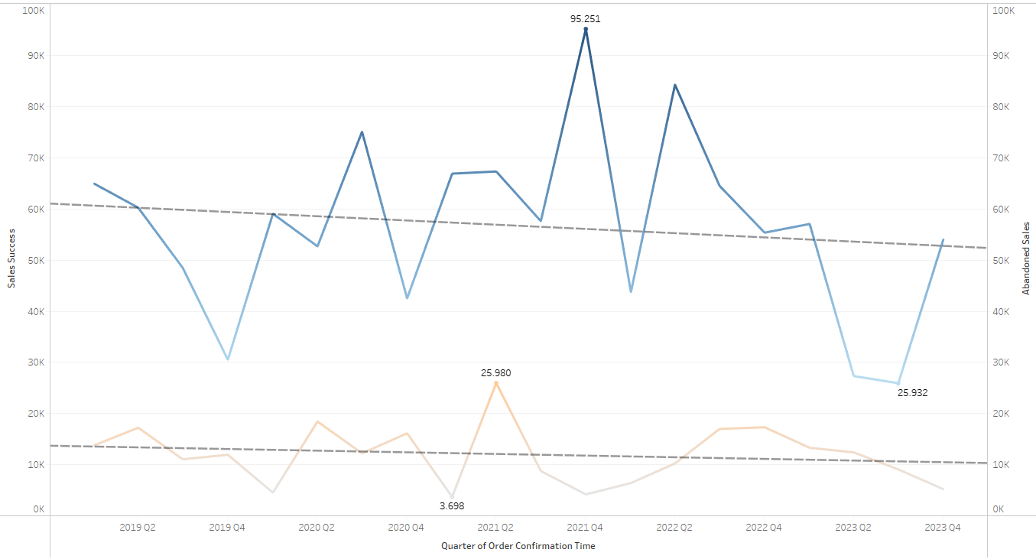
Data Visualization
Success Sales & Abandoned Sales Trend

Slide 8
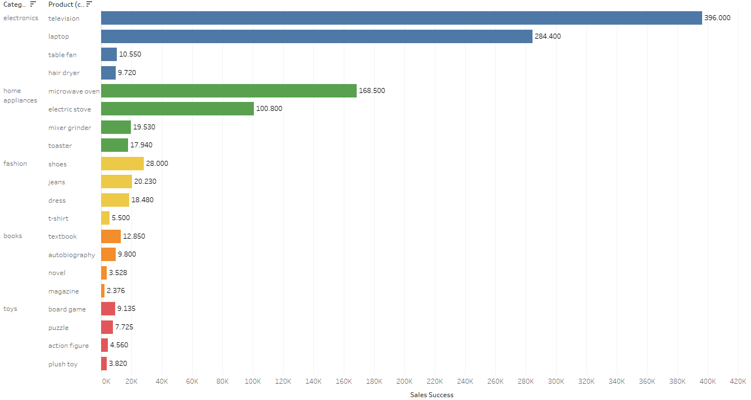
Data Visualization
Sales (Sales Success) per Product Categories

Slide 9
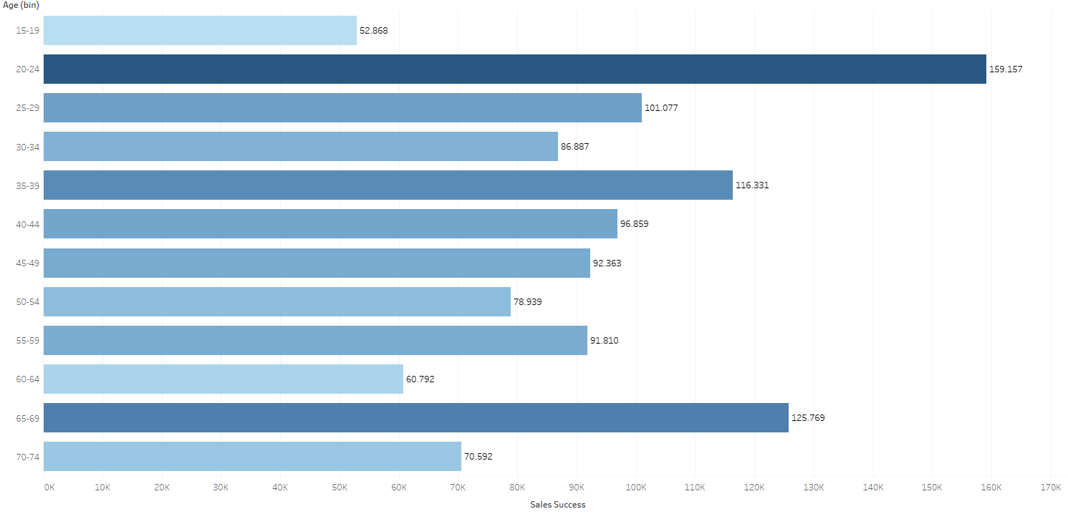
Data Visualization
Age Distribution per Sales (Sales Success)

Slide 10
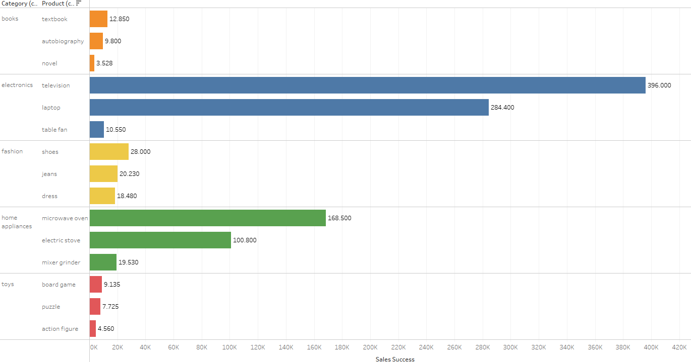
Data Visualization
Top Three Product for Each Categories

Slide 11
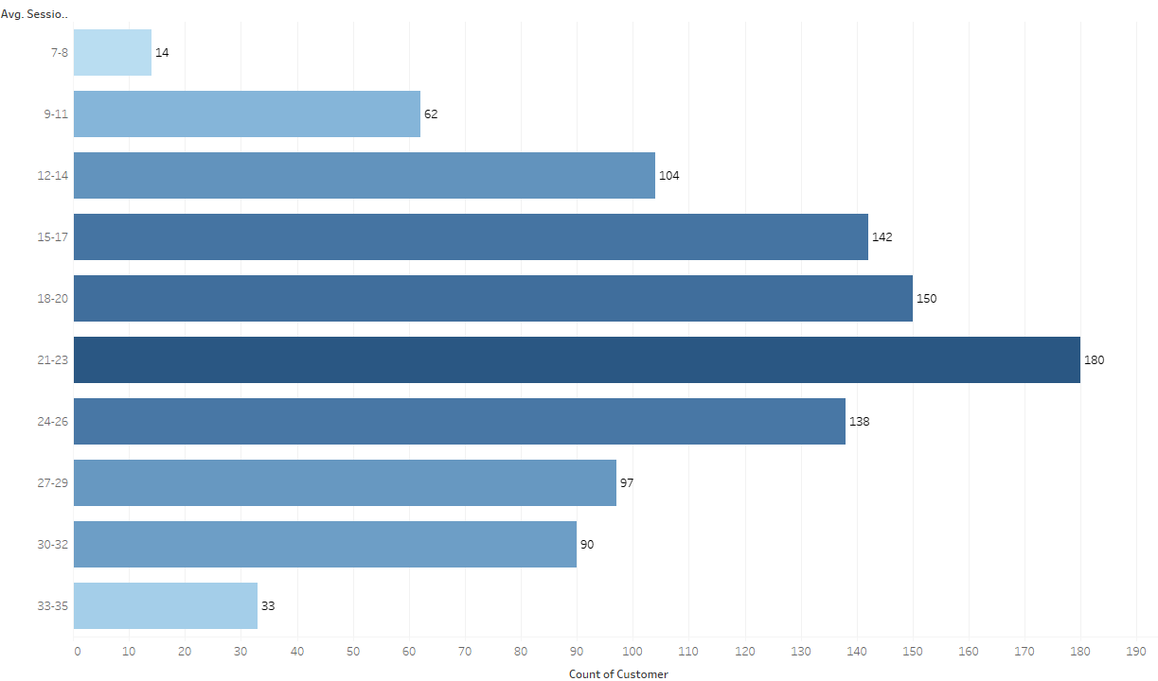
Data Visualization
Average Session Duration (minutes) bin per Customer

Slide 12
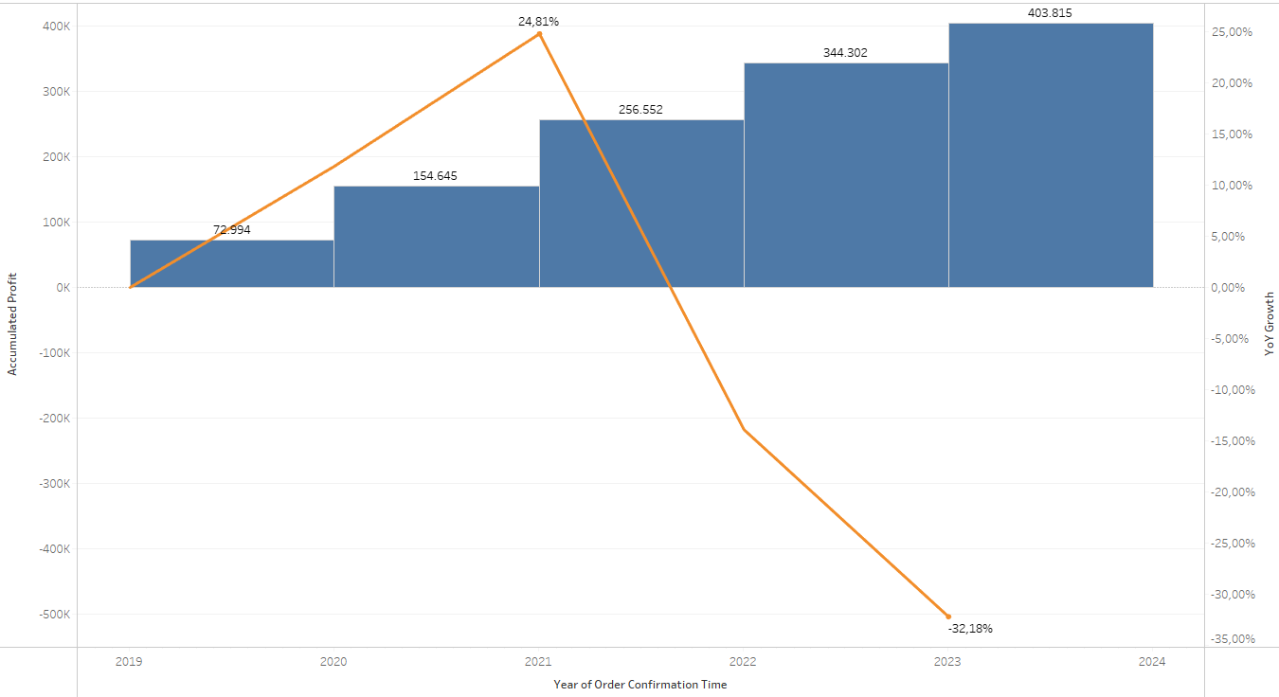

Data Visualization
Accumulated Company Profit per Year & Growth Profit YoY

Slide 13
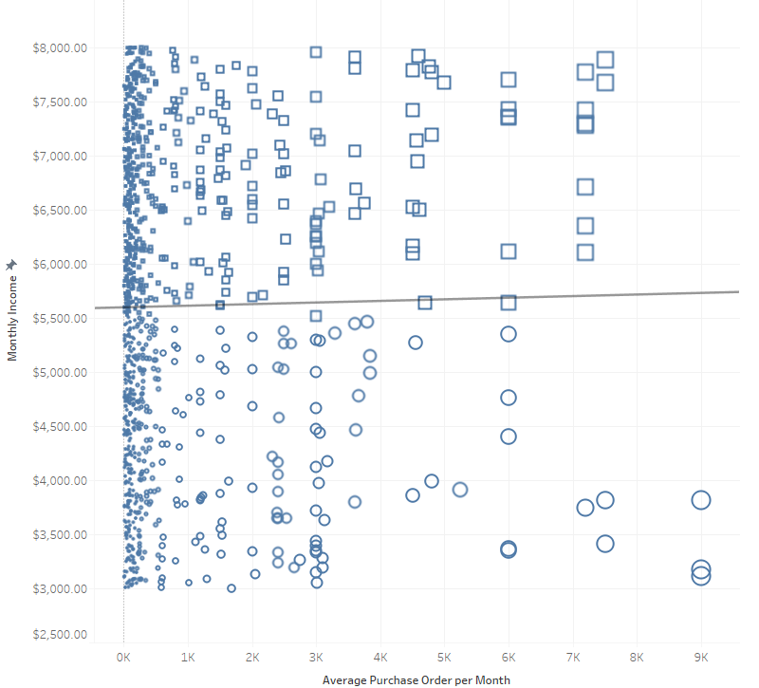
Data Visualization
Average Purchase Order per Month & Monthly Income Correlation

Slide 14
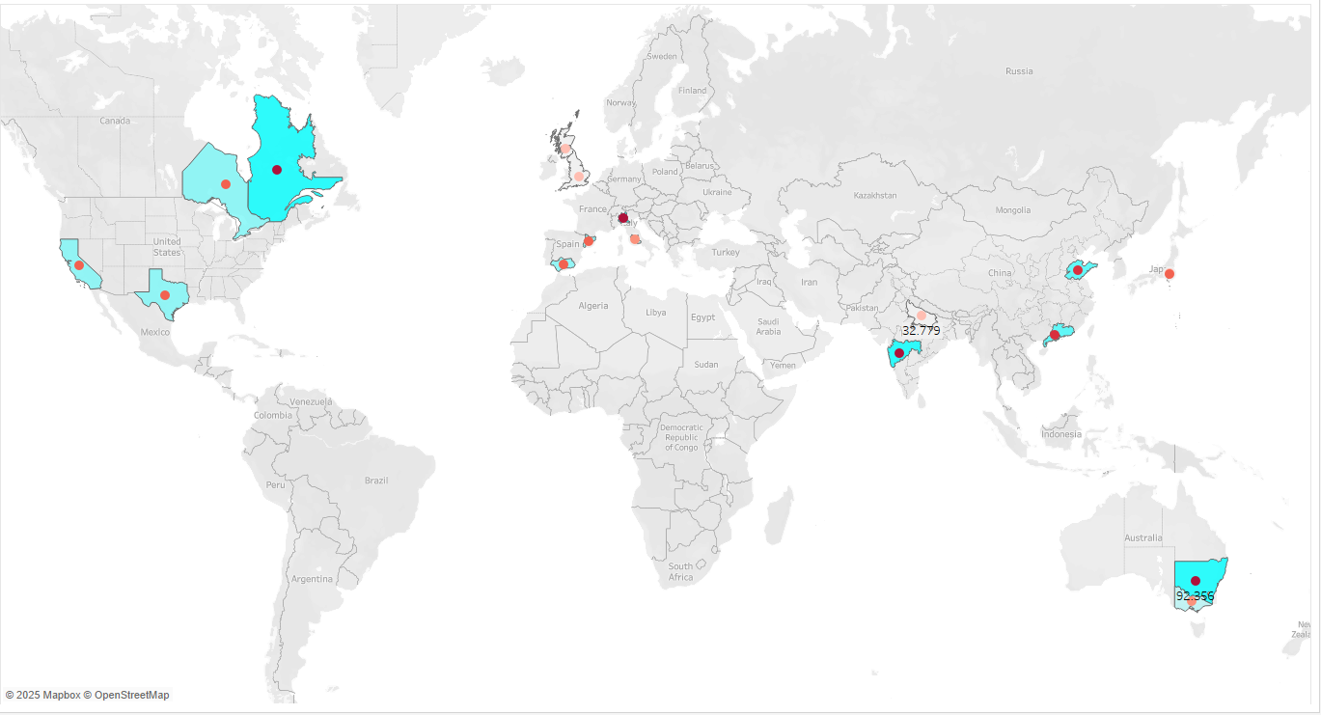
Data Visualization
Total Sales (Sales Success) & Market Share in Every Country

Slide 15
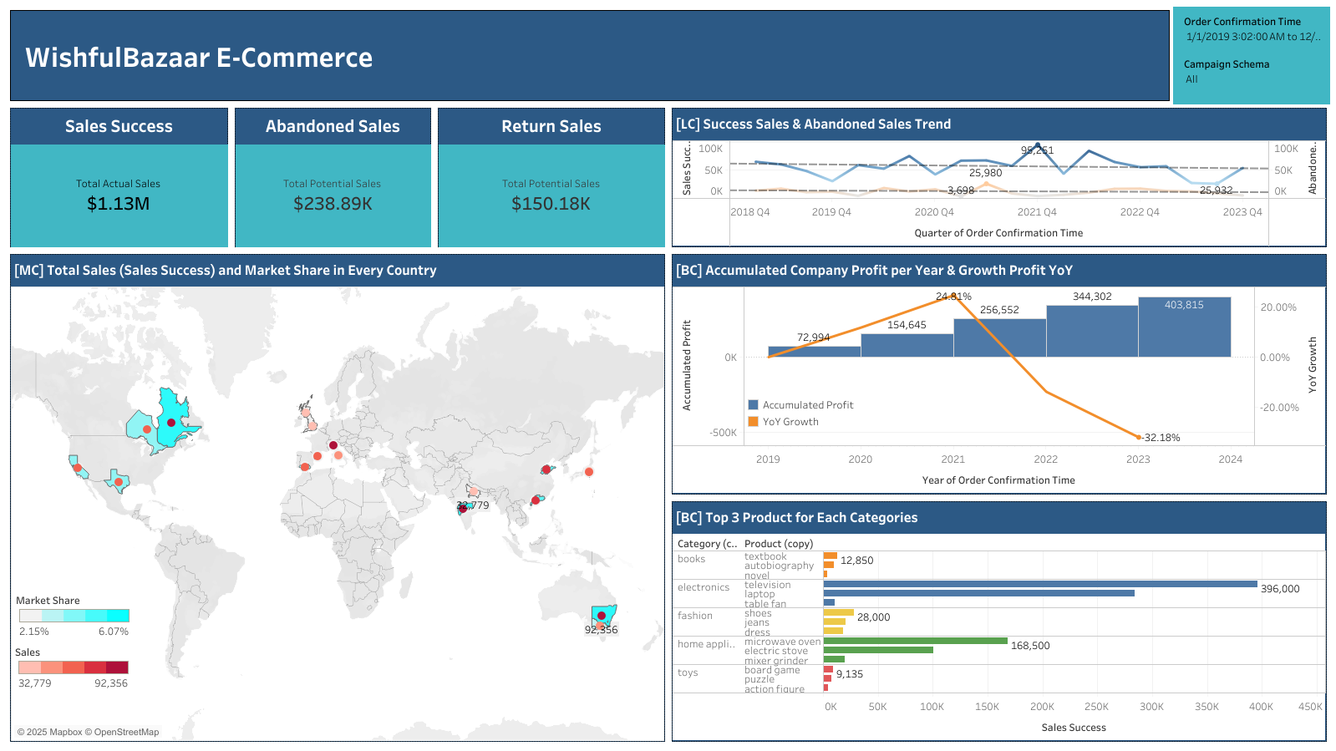

Slide 16
Insights
Our company has total Sales Success 1,13M when has a total potential sales that can not be converted into total actual sales for 238,89K in Abandoned Sales and 150,18K in Return Sales from Jan 1, 2019 to Dec Dec 31, 2023.
The most significant growth in our actual sales amounts happened in quarter 4 of 2021, when the number of abandoned sales is relatively small.
Most payments use credit card methods, as much as 36.45 % of the total actual sales transactions. Followed by debit cards, cash on delivery, and PayPal, at 28.95 %, 25.29 %, and 9.31 % respectively.
The most profitable product of all actual sales is televisions, followed by laptops and microwave ovens.
The most active age range for making purchase transactions is 20-24, followed by 65-69, and 35-39.

Slide 17
Insights
The most average session duration range each customer who makes a purchase between 21-23 minutes.
The highest profit occurred in 2021 with a profit amount of 101.907 and growth YoY value of 24.81%.
The correlation between average purchase order per month and customer’s monthly income is very weak, most likely no meaningful correlation.
Country that generated the largest sales was Australia, controlling 6.07% of the market share. Otherwise, India has the lowest sales with only controlling 2.15% of the market share.

Slide 18
Recommendations
Sending friendly reminder emails or texts for customer with abandoned sales to give some special incentives like discounts or free shipping could help nudge people to finish their purchases.
Better product descriptions and customer reviews could help set the right expectations could reduce buyer's remorse, especially for big-ticket items like TVs.
Offer bundled deals (like pairing TVs with soundbars or laptops with accessories).
Make a fun, interactive social media campaigns or flash sales to target the 20-24 years olds.
Offer credit card-only deals like 0% interest installment plans, cashbacks, or extra loyalty points to encourage more people to use their cards.
Add features like smart product recommendations or better search filters to engage the customers within 21-23 minutes per session.

Slide 19
Thank You
For Your Attention …
by
Batch
Assignment
Linkedin
Link
Ahmad Rizki
RevoU FSDA batch FEB25
Intermediate
Data Visualization
www.linkedin.com/in/arizabdulhanan
Tableau Link

